Slide 1

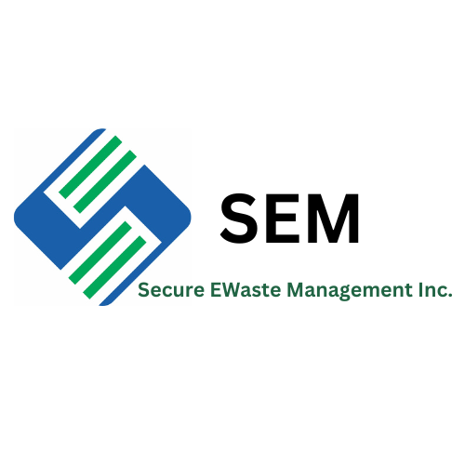
Secure EWaste Management
5220 Edison Ave
Chino, CA 91710

Slide 2


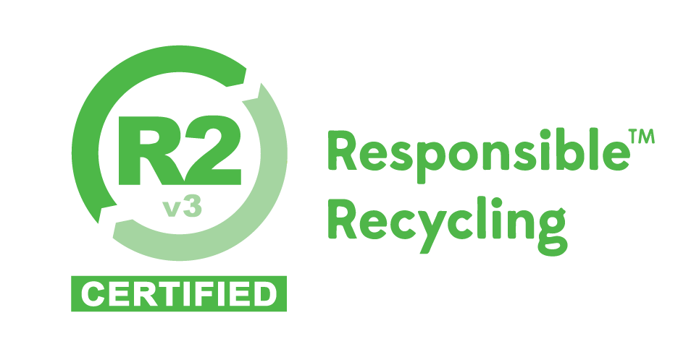
Who Is SEM?
SEM was developed for meeting customer requirements and reducing SEM’s impacts on the environment.
SEM was providing complete lifecycle solutions, data destruction, testing and dismantling for recycling in a safe and secure manner

Slide 3
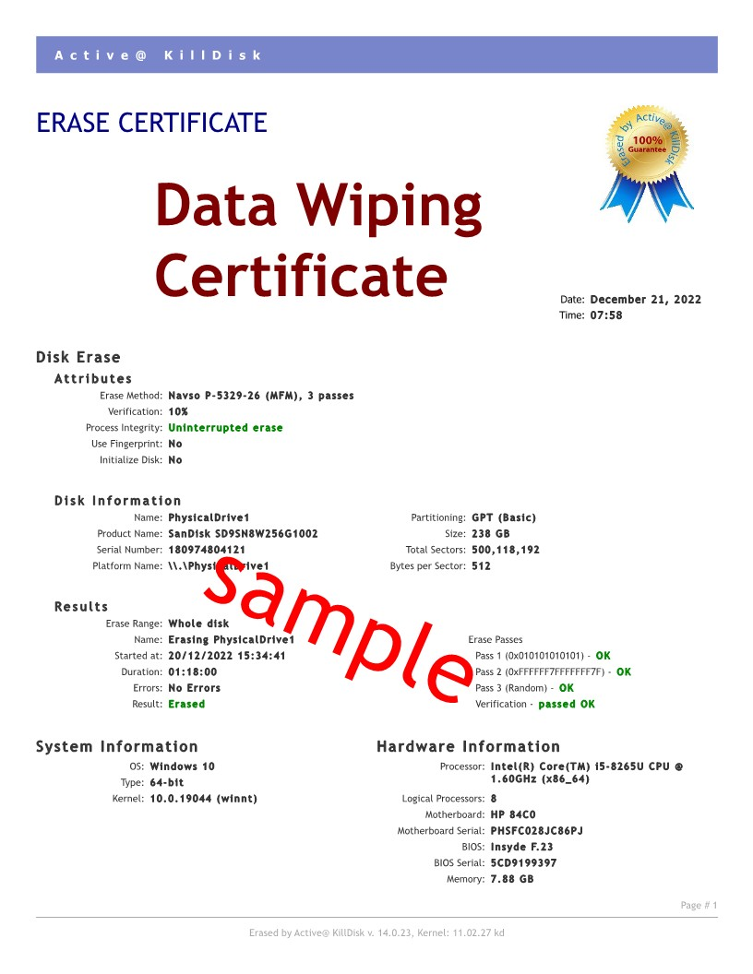
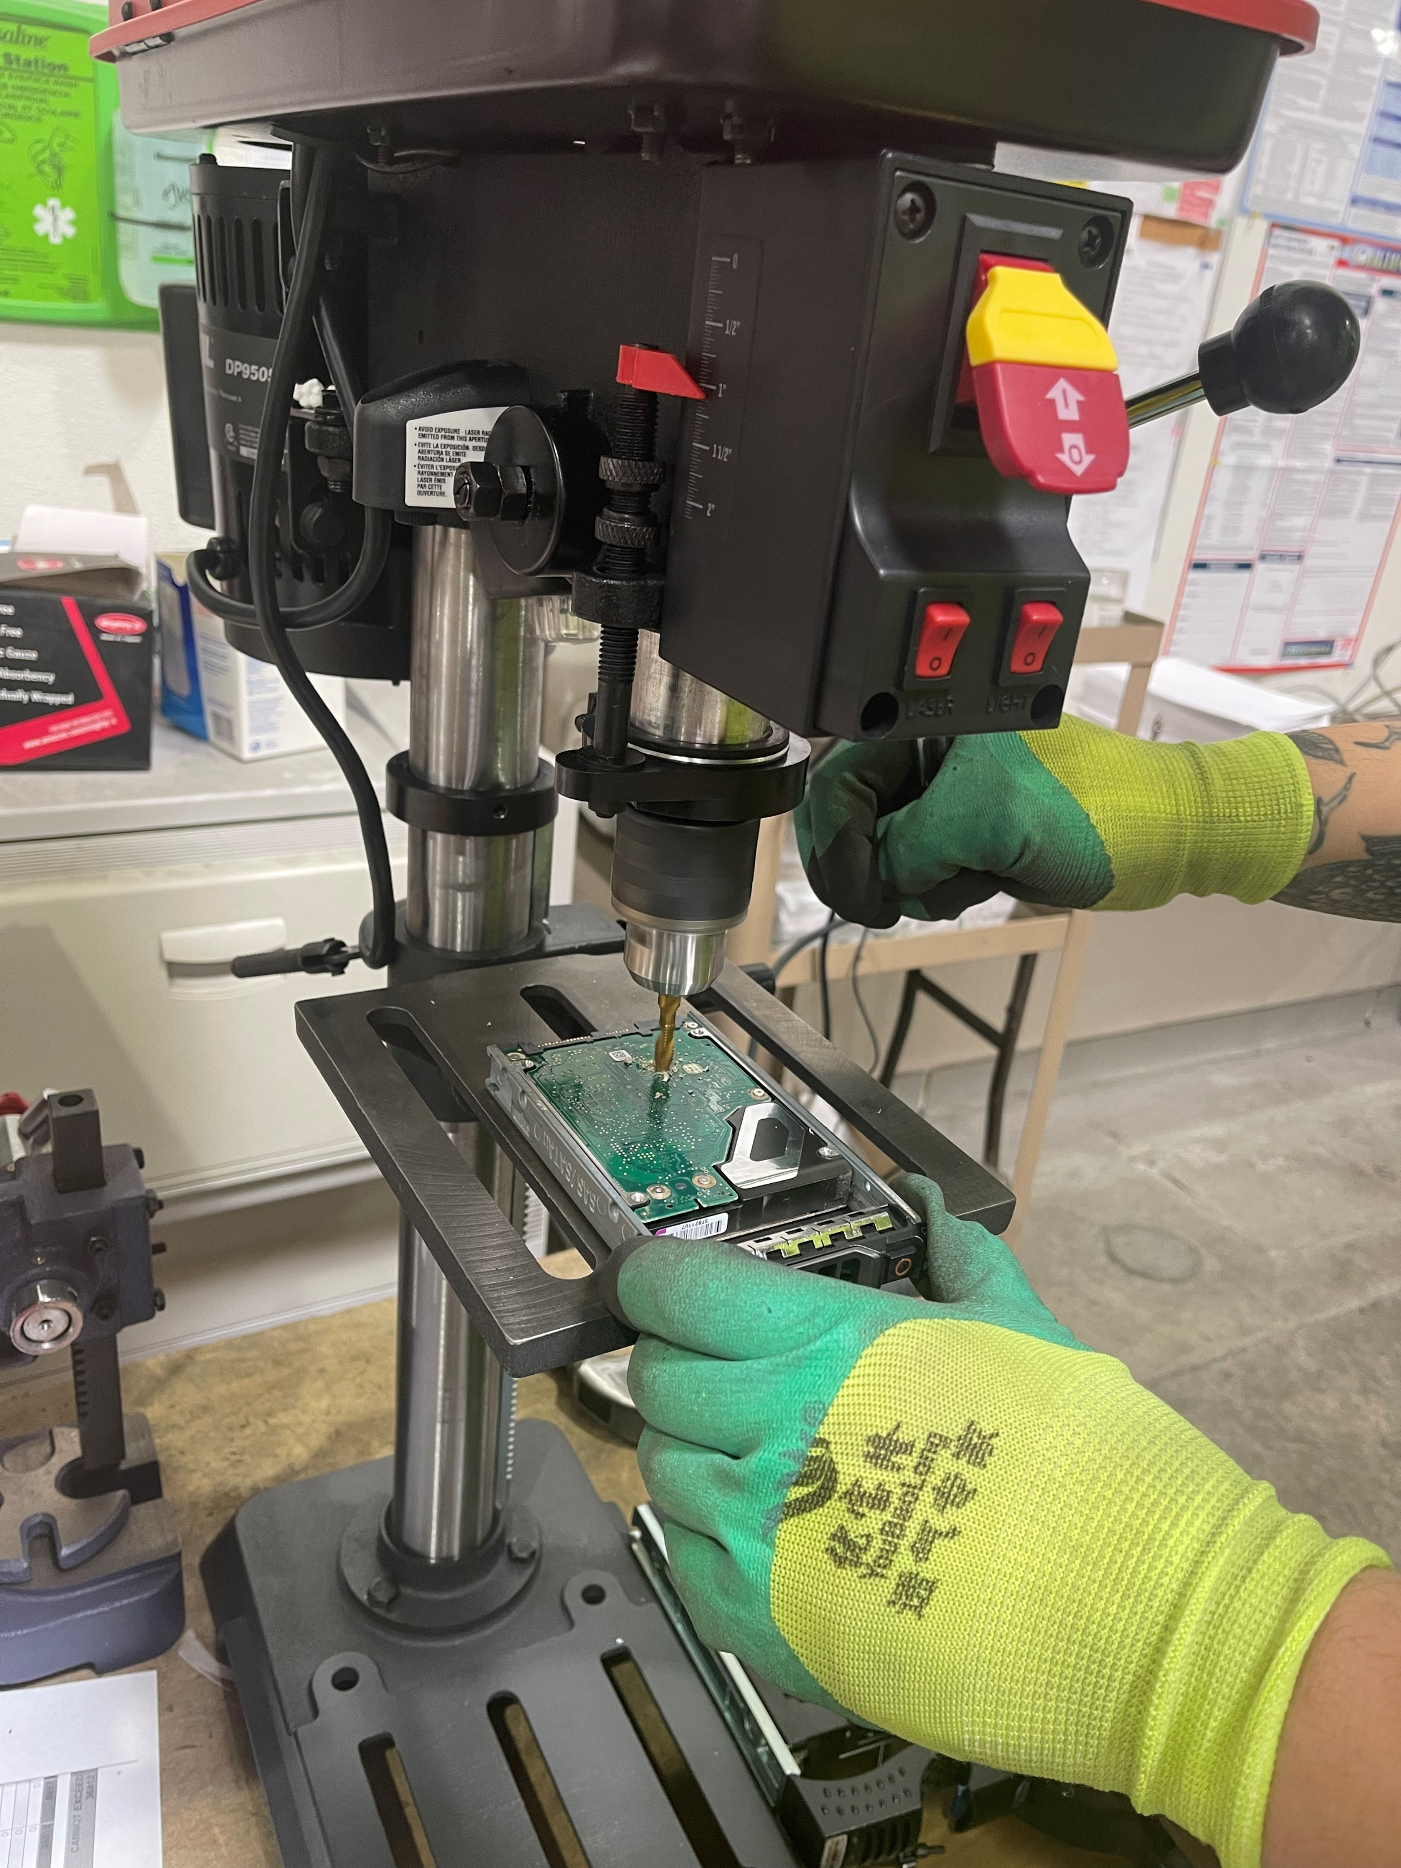
Service we Provide
Pick-up
Sorting
Data Destruction
Dismantling

Slide 4
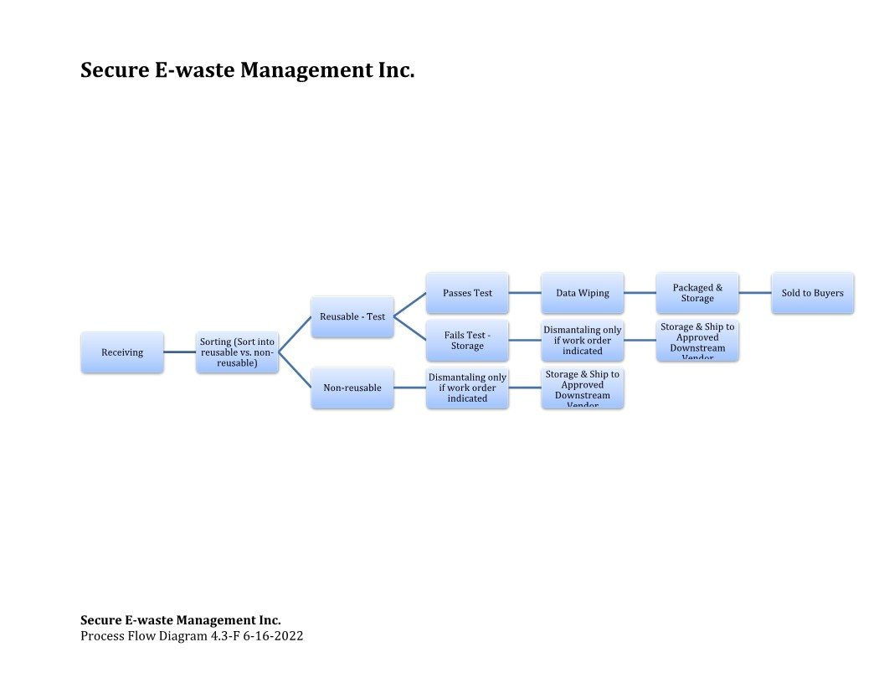
SEM Flowing Chart

Slide 5
Data Destruction Procedure
Privacy is our priority
All assets regardless of type MUST have all identifying stickers, labels, asset tags, business cards, documentation and any other markings that relate to the original owner removed from the equipment
    Hard drives are tested and wiped using Active@ KillDisk Pro.
      This method is used by the Department of Defense, # 5220-22.M and meets the requirements of NIST 800-88 guidelines.
      The method is a three-pass wipe using random characters, complements of characters, and random data streams.

Slide 6
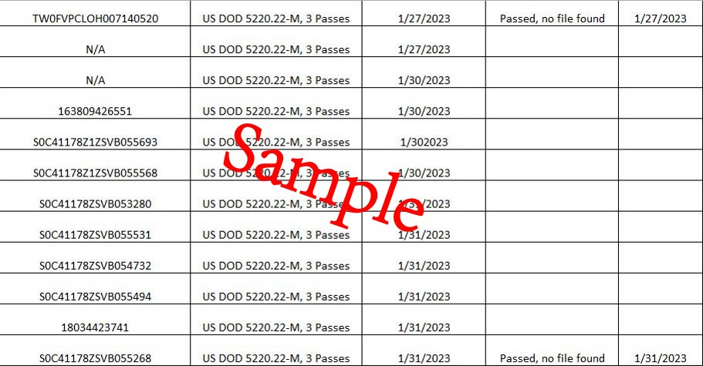
Data Destruction Procedure
All employees involved in data destruction shall receive training upon hire and annual refresher training.
SEM validates data destruction methods and security controls used through independent verification.

Slide 7
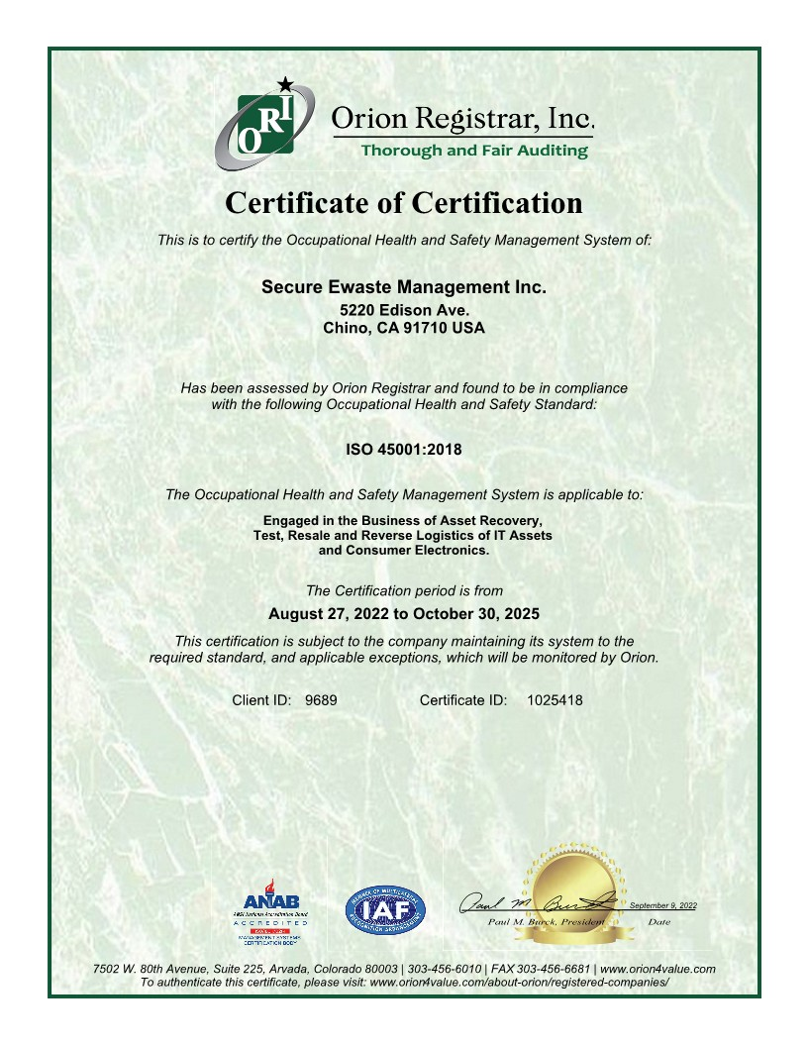
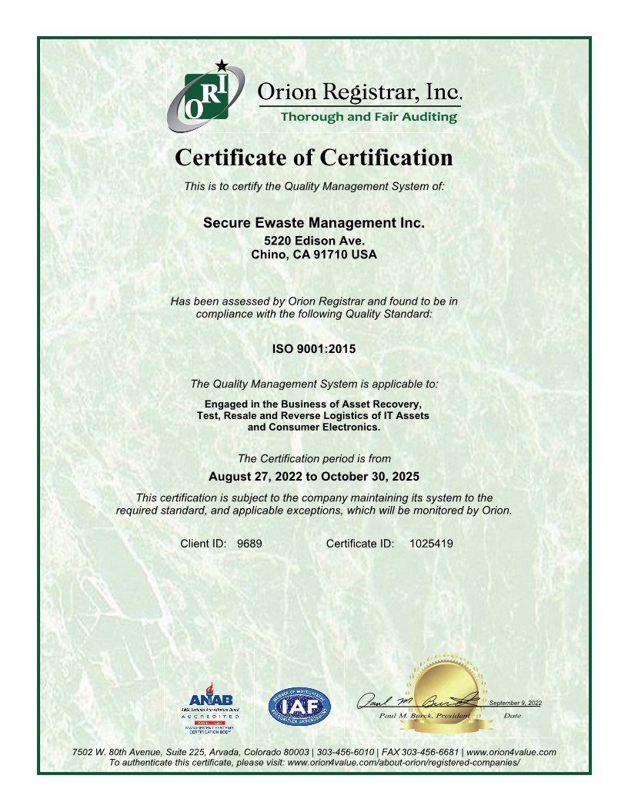
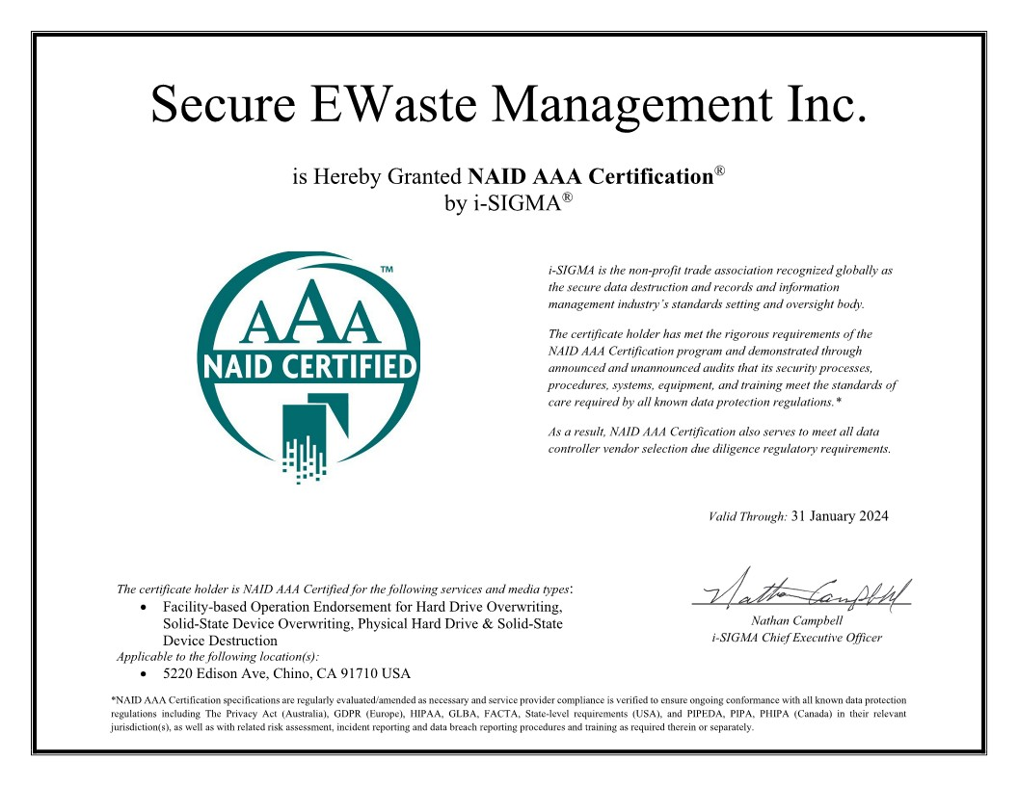
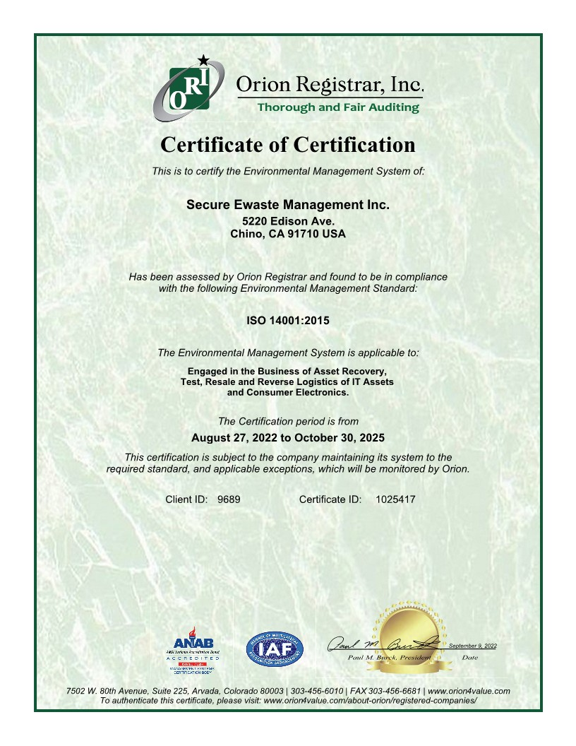
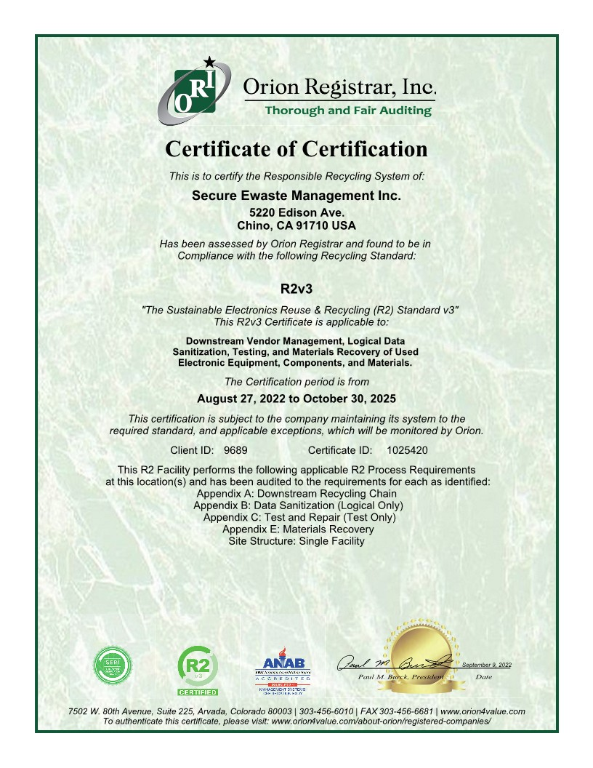
Certificates

Slide 8
https://www.sem-recycling.com/
Service Secure Recycle

